Slide 1


Slide 2

OneCare, an innovative all-in-one healthcare web app designed to revolutionize the way you manage your health and wellness.
CS 691 CAPSTONE PROJECT

Slide 3
Team Member Roles and Responsiblities
Improvements made from Professor Feedback
Project Description
Team working agreement
Personas (at least 3)
MVP
Technologies
Algorithms
Diagrams
Architecture Diagrams, Context Diagram, ER Diagrams, Sequence
Sprint 2 Recap
Product Backlog
Stories or Tasks committed for this Sprint ( Storie and Acceptance Criteria)
Sprint Summary
Test Cases
Stories completed and Stories not completed
API usage in the Application
Metrics
Team velocity
Burndown Charts
Retrospective
Project Demo ( current sprint)
Github link

Slide 4

TEAM MEMBERS AND ROLES

Slide 5

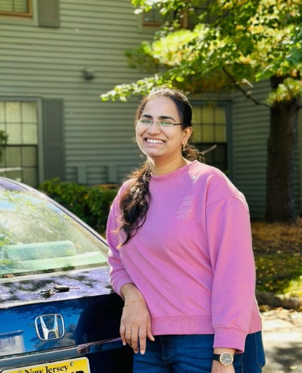
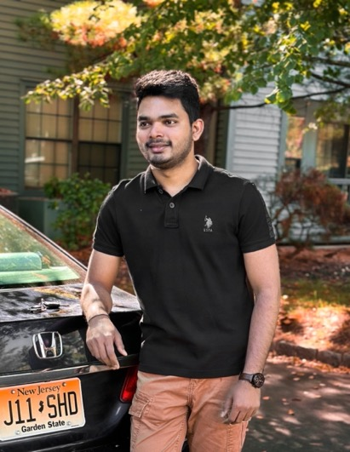
TEAM MEMBERS AND ROLES
Aishwarya More Software Developer & Business analyst (am99715n@pace.edu)
Naga Lavanya Mukku Backend Developer & Software test Engineer (nm26028n@pace.edu)
Shiva Krishna Maddela Software Developer & Devops Engineer (sm69485n@pace.edu)

Slide 6
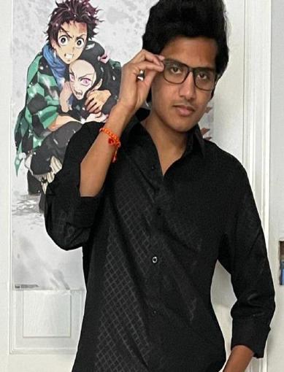

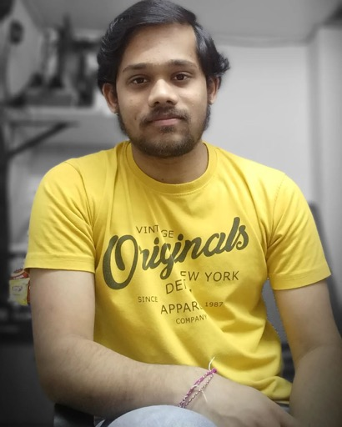
TEAM MEMBERS AND ROLES
Pushpak Kamisetti Software Developer & Machine Learning Engineer (pk39545n@pace.edu)
Afroze Fatima Software Developer (an75415n@pace.edu)
Shashidhar pinumalla Front End Developer (sp16592n@pace.edu)

Slide 7

PROJECT DESCRIPTION
OneCare is a comprehensive healthcare management application designed for both patients and doctors. It serves as a unified platform that facilitates seamless communication, appointment scheduling, and the organization of medical records, predict medicines based on symptoms , medication reminders to stay on track with their treatment plans, while stress management tools, such as recorded meditation sessions, promote mental well-being. OneCare aims to simplify healthcare management and promote healthier lifestyles. Our app, OneCare Health, leverages Firebase's real-time database and authentication features to provide a seamless and secure experience for users. It enables patients to manage their health records, appointments, and prescriptions, while healthcare providers can efficiently access patient information and communicate with their patients.

Slide 8
Improvements made from Professor’s Feedback
Alignment with Conceptual Diagram: Incorporated distinct layers such as Presentation Layer and Business Layer into the architecture diagram to align it more closely with the Conceptual Diagram.
Transition to Story Points: Transition from using Date Completed as a metric to utilizing Story Points for tracking Stories
Inclusion of Story Point Estimates: Included Story Point estimates for each story before the commencement of sprints in Jira in the Burndown chart.

Slide 9

Team Working Agreement

Slide 10
TEAM WORKING AGREEMENT
Participation:
Prompt Attendance: Attend meetings on time.
Regular Attendance: Notify earlier if unable to attend.
Communication:
Zoom Meetings: Weekly, meaningful discussions with cameras on.
Whatsapp Group: Quick communication & urgent matters.
OneDrive: Sharing final deliverables & collaborative editing.
Database Management: Efficient organization of project data.
Work Distribution:
Equal Division: Fair allocation of tasks.
Deadline Responsibility: Complete tasks on time.
Collaboration: Seek help if needed.
Meetings:
Virtual Meetings: Every Tuesday & Wednesday via Zoom.
Facilitation: Productive discussions & progress tracking.
Meeting Minutes: Document for progress monitoring.

Slide 11

Personas

Slide 12
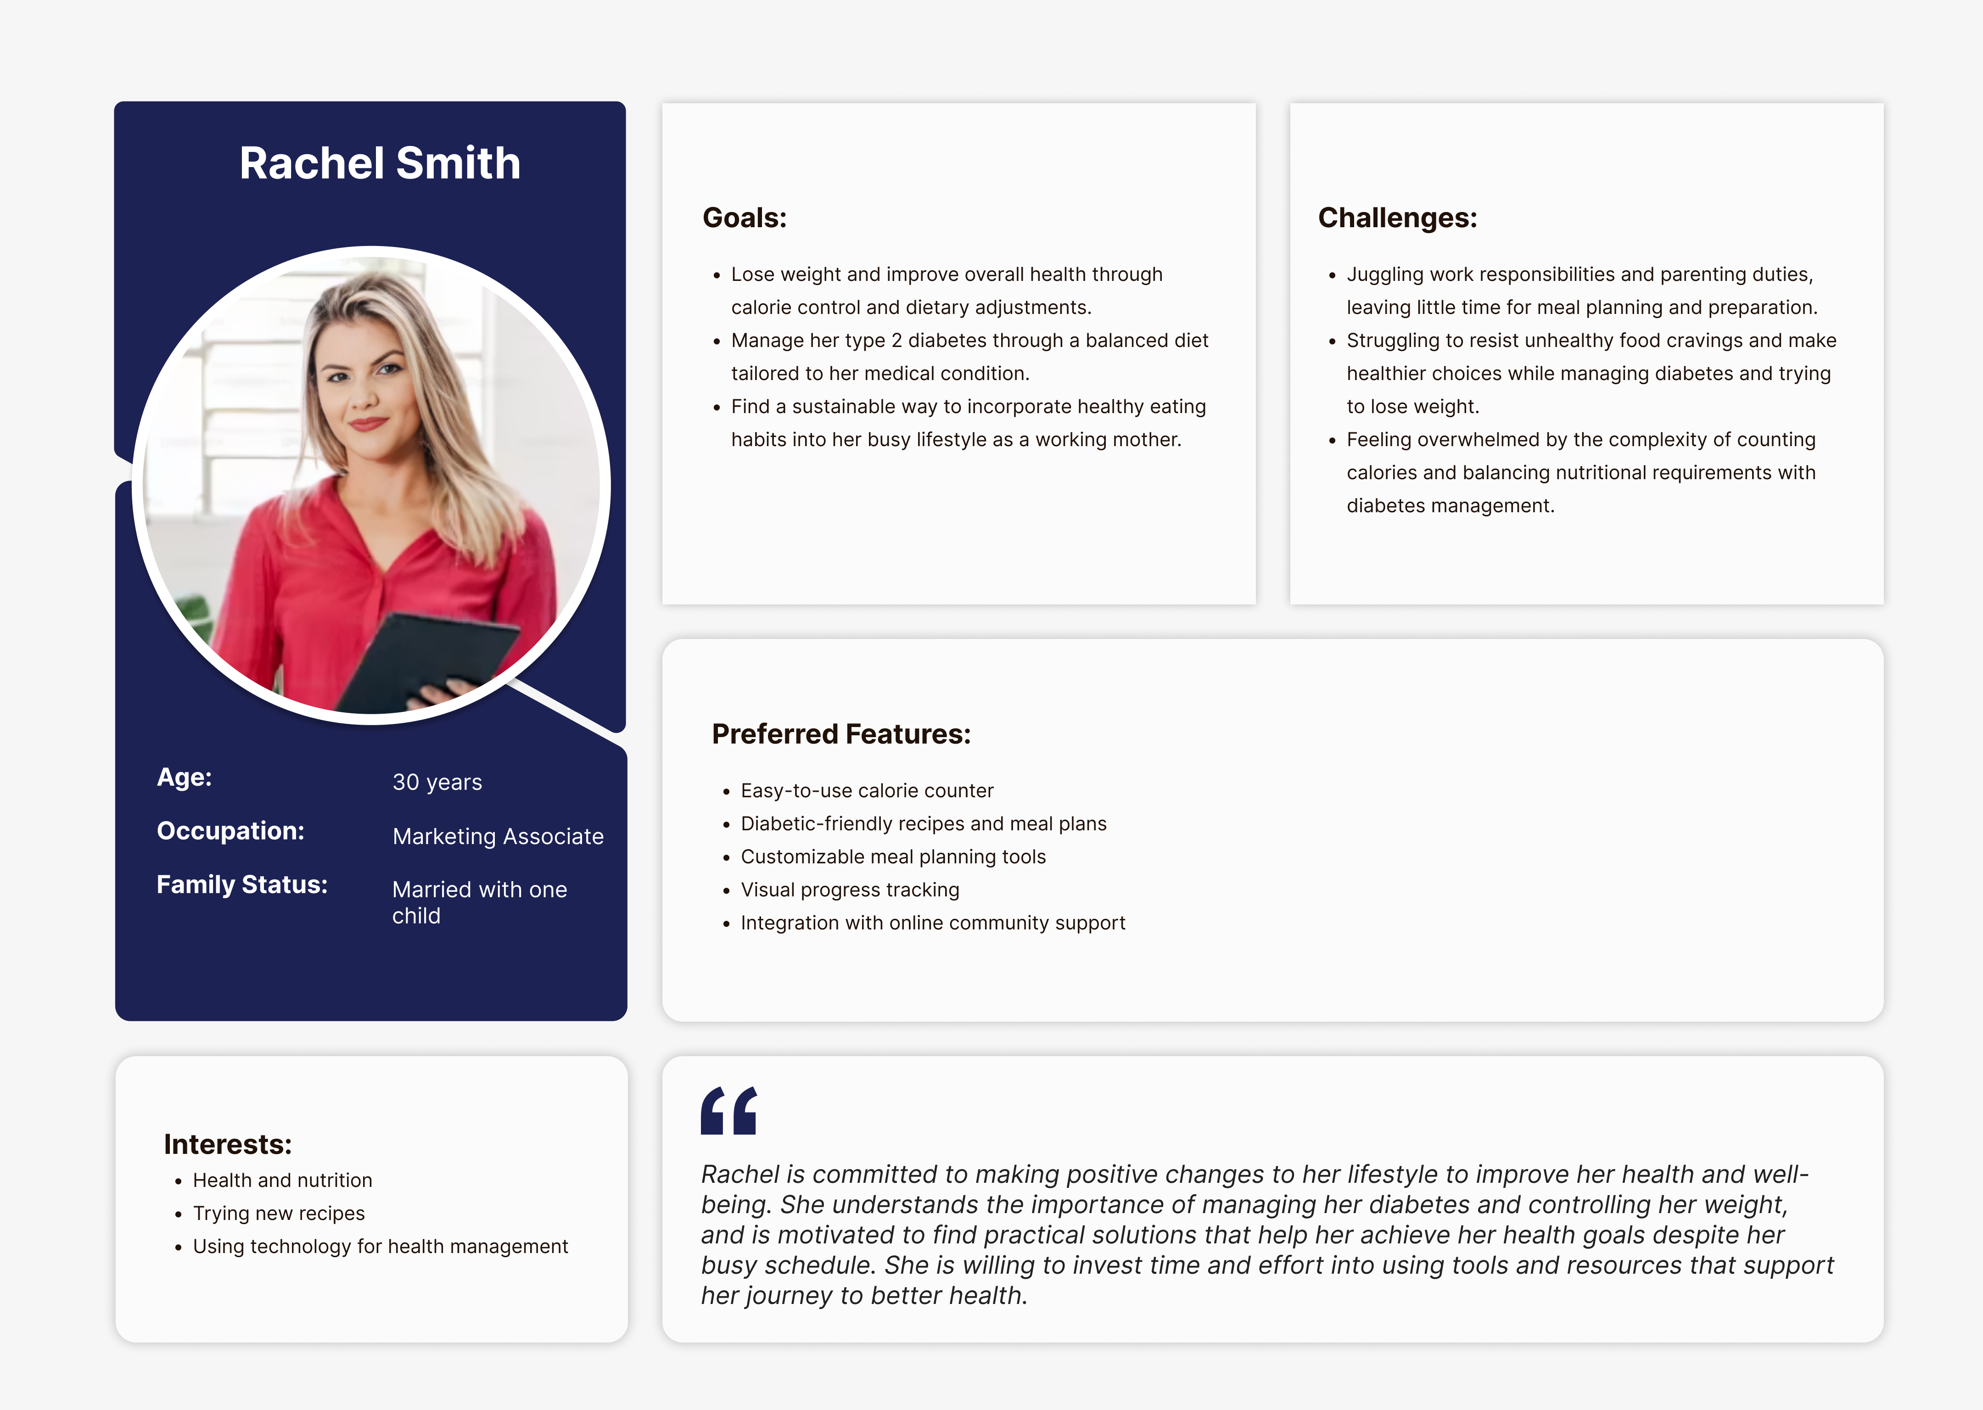

Slide 13
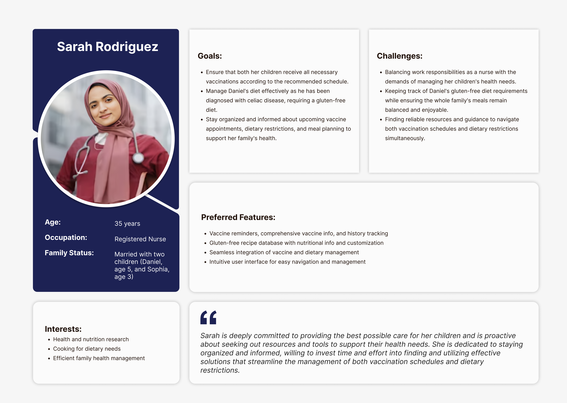

Slide 14
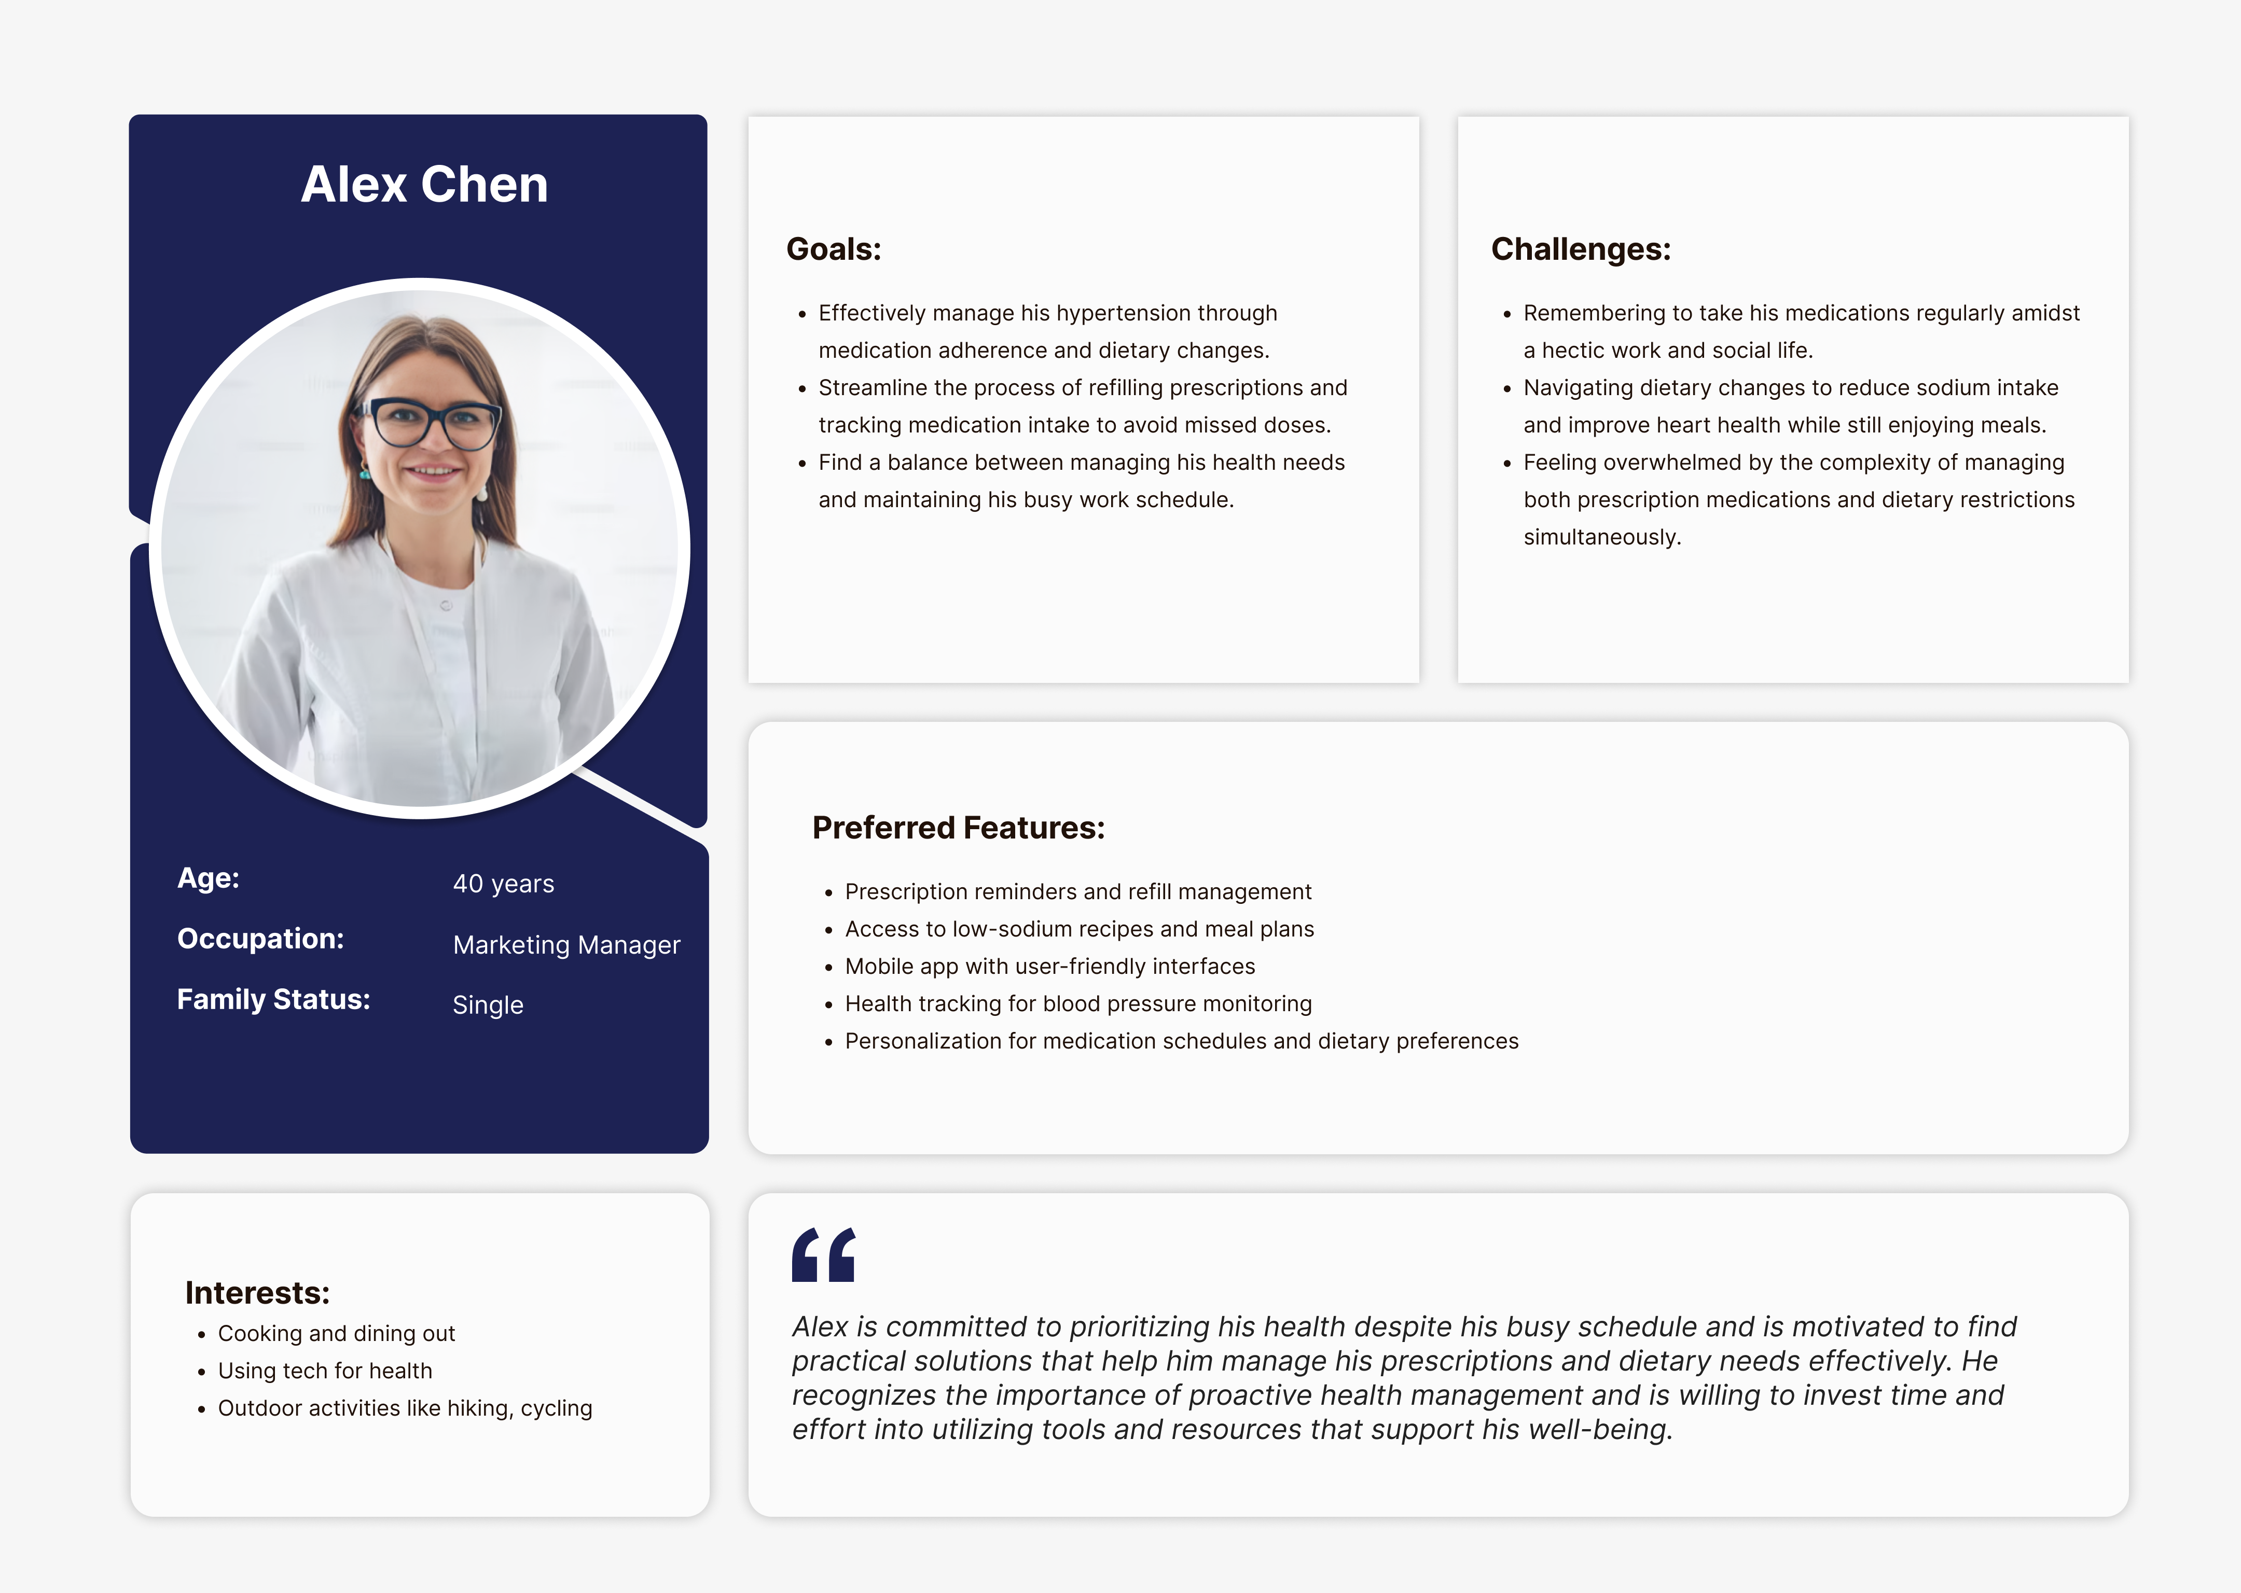

Slide 15


Slide 16
Minimum Viable Product (MVP)
Homepage
Appointment Booking And Management
Medication Reminder
Lab Test Booking
Meditation Session
Search doctor
Health Resources
Symptoms Tracker

Slide 17













Technologies

Slide 18

ARCHITECTURE DIAGRAM

Slide 19
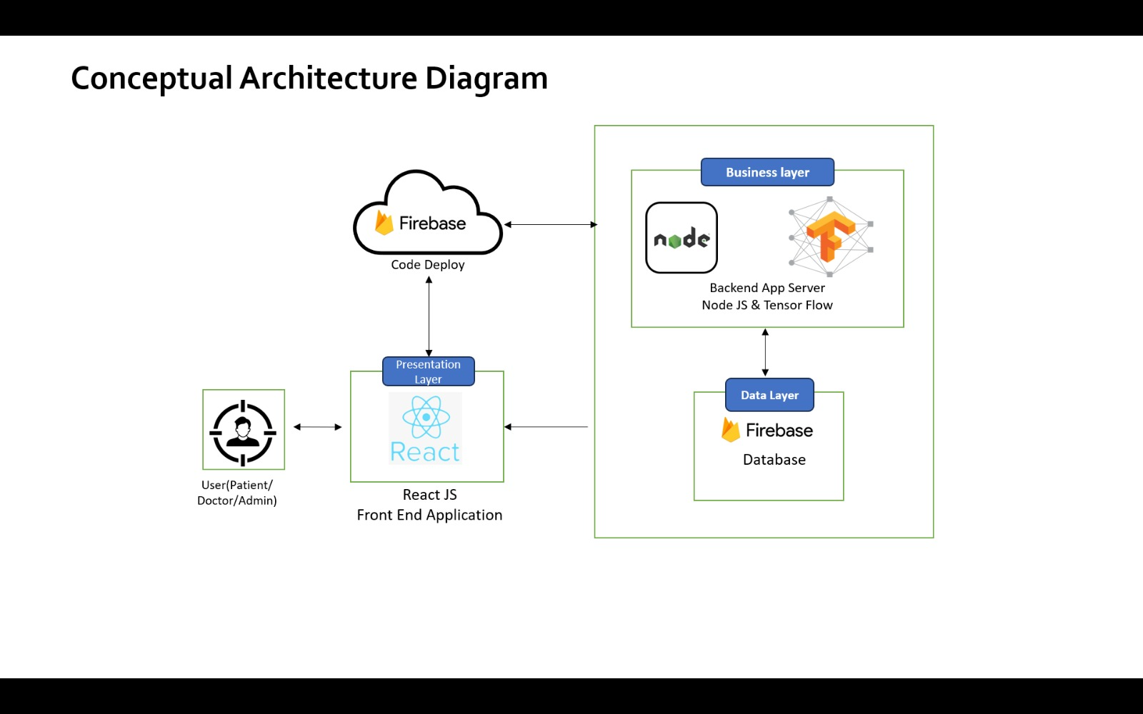

Slide 20

SEQUENCE DIAGRAM

Slide 21
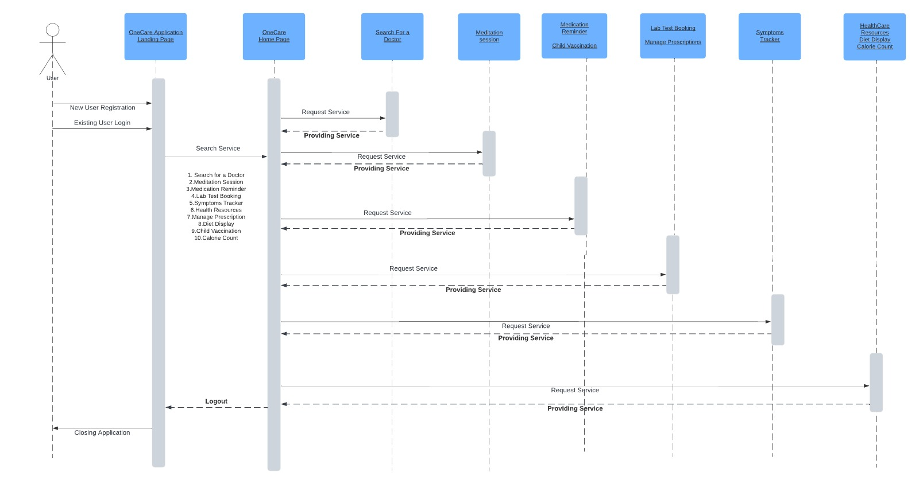

Slide 22

USE CASE DIAGRAM

Slide 23
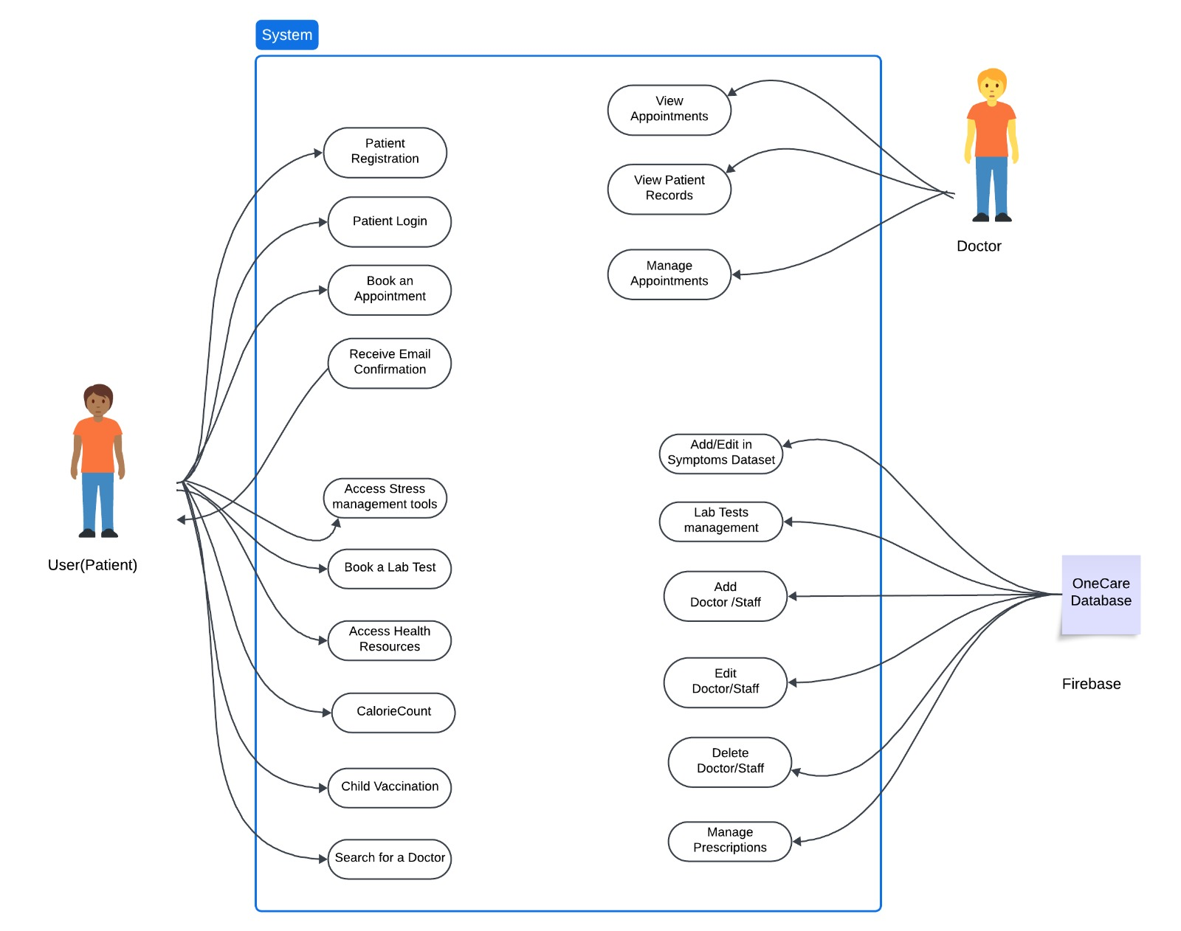

Slide 24
Sprint 2 Recap
1. Symptoms Tracker
Implementation of Symptom tracker functionality
2. Medication Reminder
Developed and deployed Medication Reminder feature
3. Search Doctor
4. Lab Test Booking
Created a user-friendly lab test booking functionality
Designed and implemented Search doctor based on location and speciality

Slide 25

ACCEPTANCE CRITERIA AND USER STORIES

Slide 26
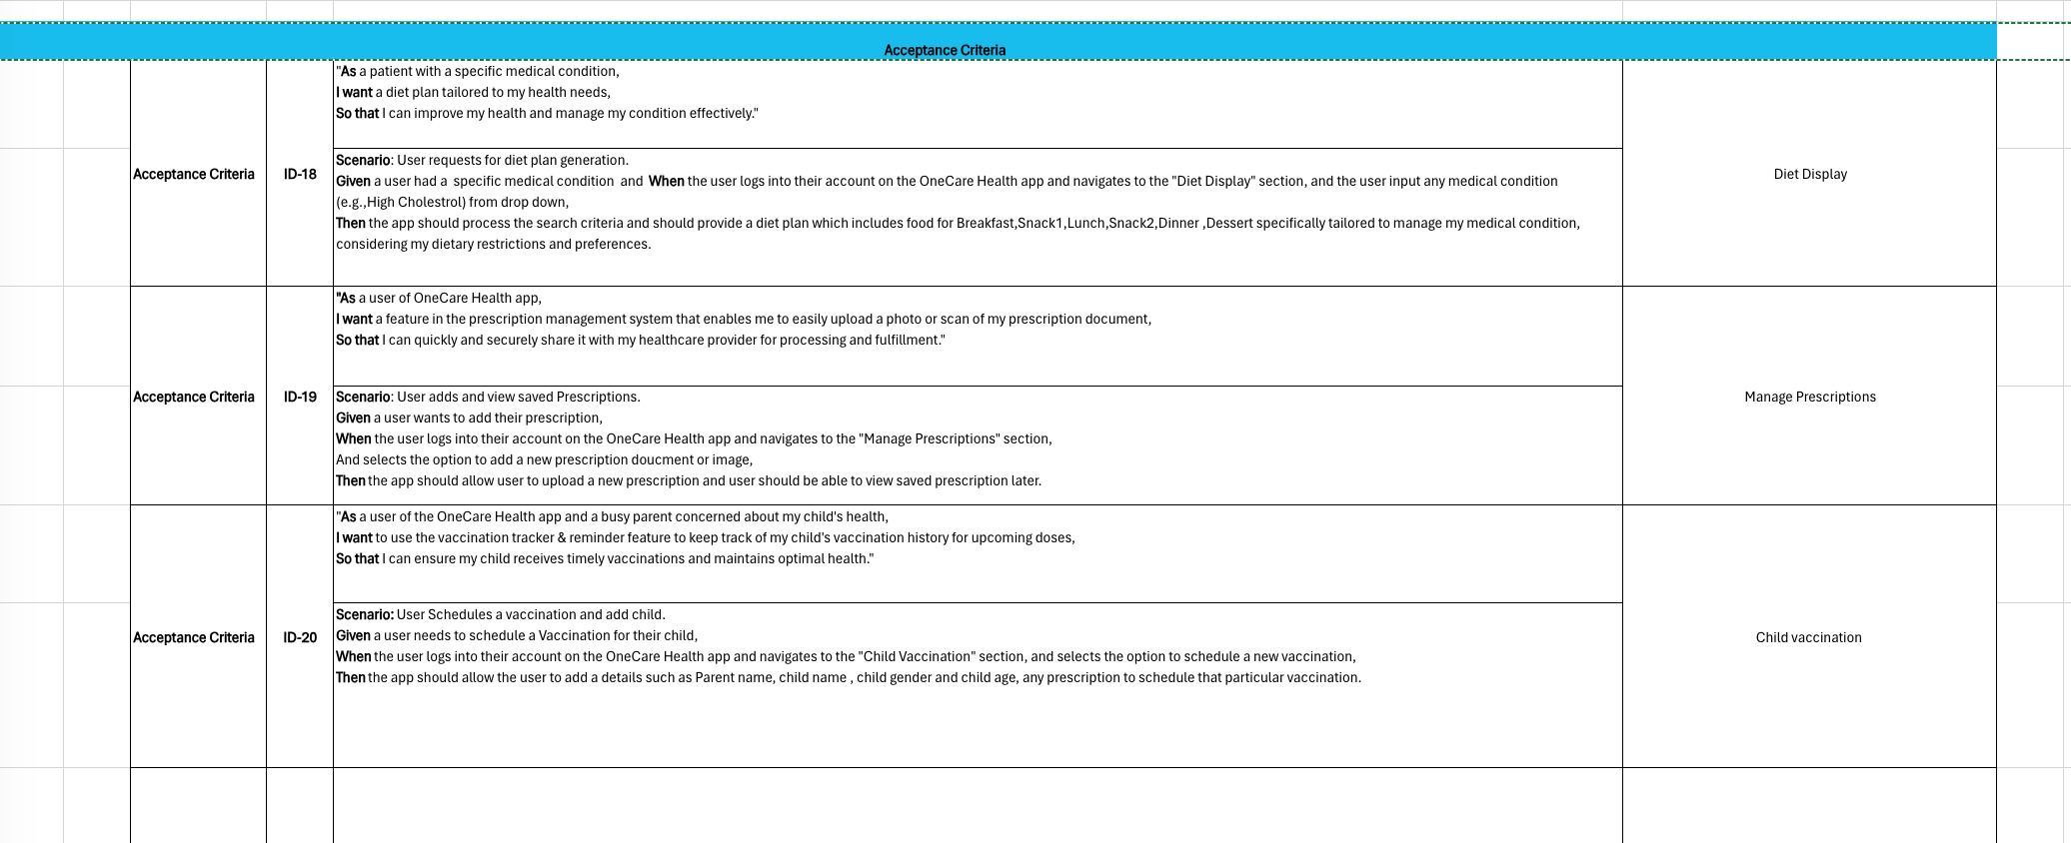
ACCEPTANCE CRITERIA AND USER STORIES

Slide 27
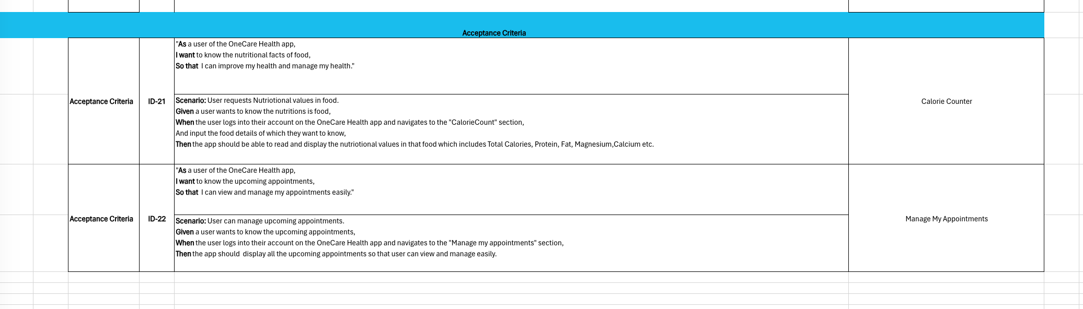
ACCEPTANCE CRITERIA AND USER STORIES

Slide 28
TESTCASES

Slide 29
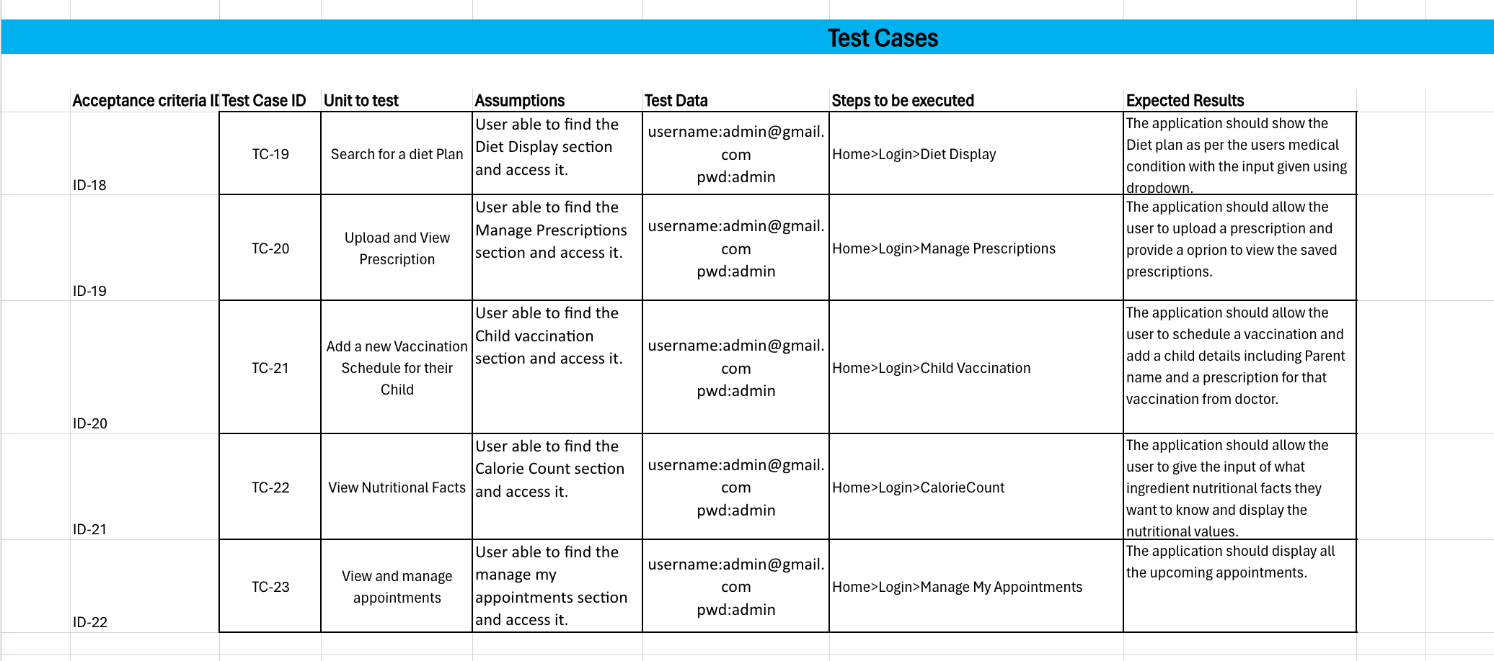

Slide 30

Sprint Summary

Slide 31
Sprint 1 Vs Sprint 2 Vs Sprint 3
Login –Doctor and Patient
Signup –Doctor and Patient
Forgot Password
Appointment booking
HomePage
Medication Reminder
Meditation session
Symptoms tracker
Search doctor
Health Resources
Lab Test Booking
Diet Display
Calorie Counter
Child Vaccine
Manage appointments
Prescription Upload and Management

Slide 32

Stories Completed and Stories Not Completed

Slide 33
Stories Completed and Stories Not Completed
Story | Status | Story Points | Date Completed
As a patient, I want a feature in the prescription management system that enables me to easily upload a photo or scan of my prescription document, so I can quickly and securely share it with my healthcare provider for processing and fulfillment. | Done | 8 | 11/04/2024
As a patient seeking to improve my health through dietary changes, I want a generate diet plan based on my specific medical condition. | Done | 5 | 29/03/2024
As a busy parent concerned about my child's health, I want to use the vaccination tracker & reminder feature to keep track of my child's vaccination history for upcoming doses. | Done | 13 | 19/04/2024
As a health-conscious user of the OneCare app, I want to calculate the number of calories in a food item quickly and easily. | Done | 5 | 03/04/2024
As a user, I want to be able to view, and manage my upcoming doctor appointments easily. | Done | 5 | 11/04/2024

Slide 34
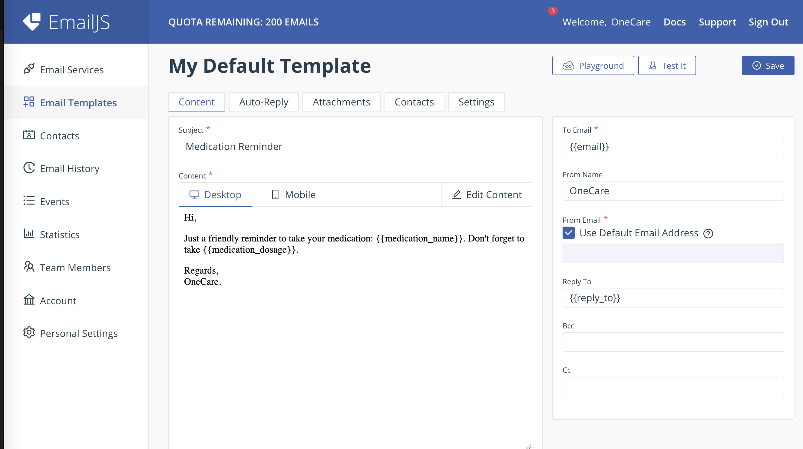
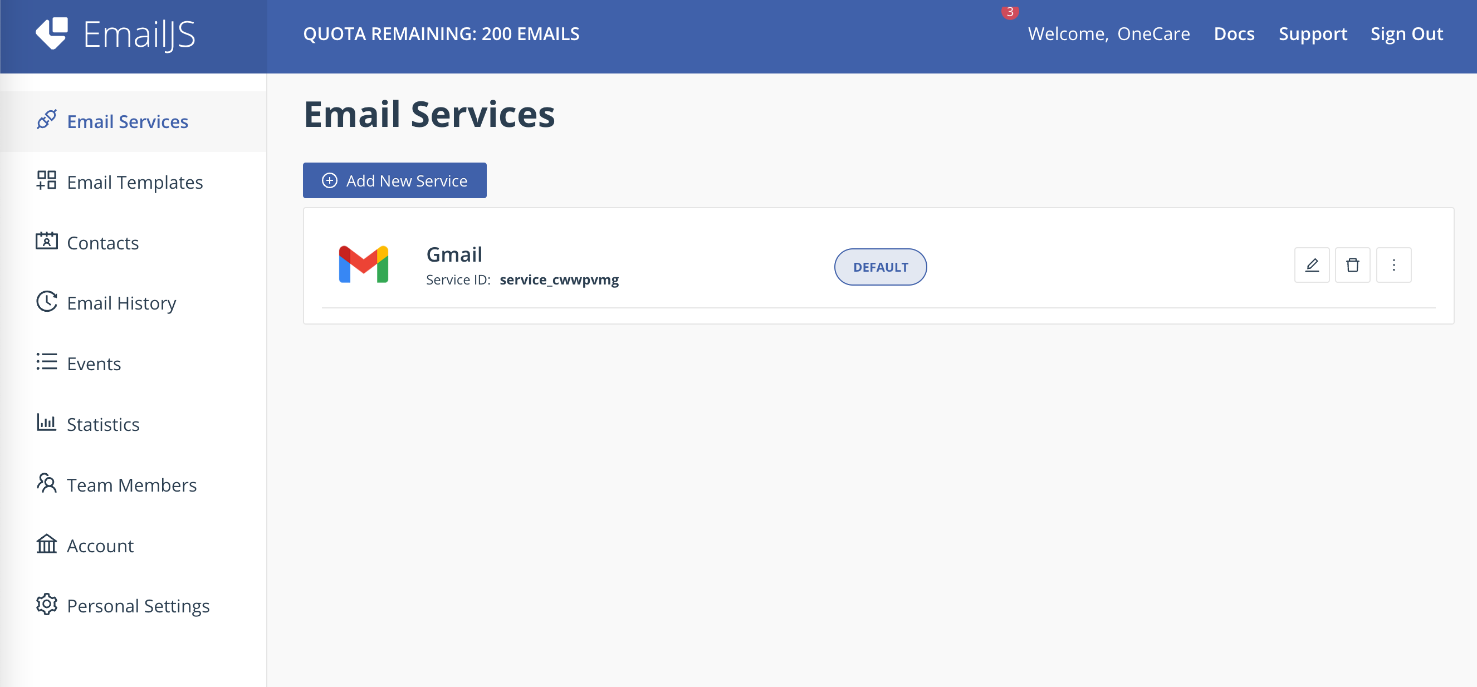
API usage in the Application

Slide 35
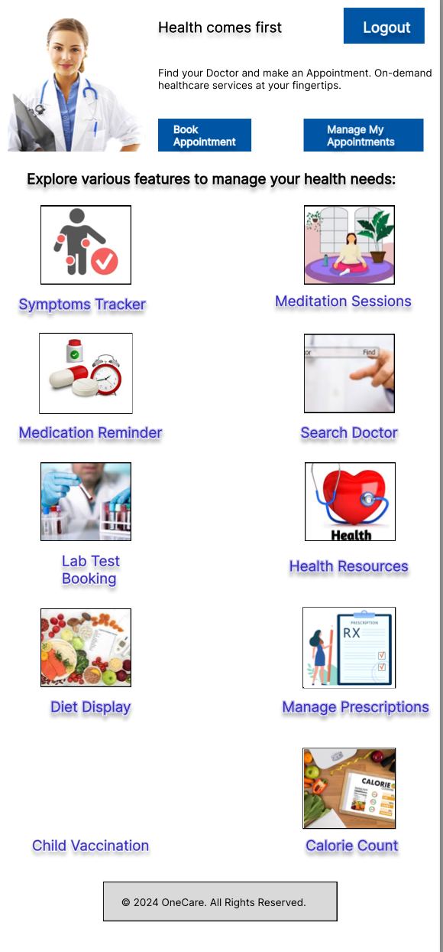
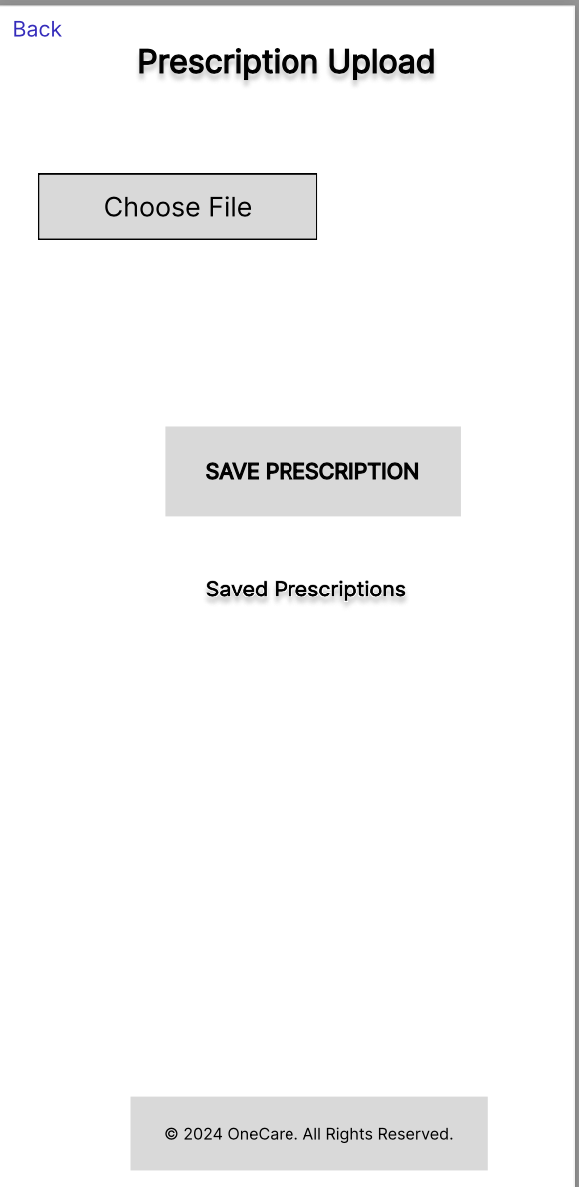
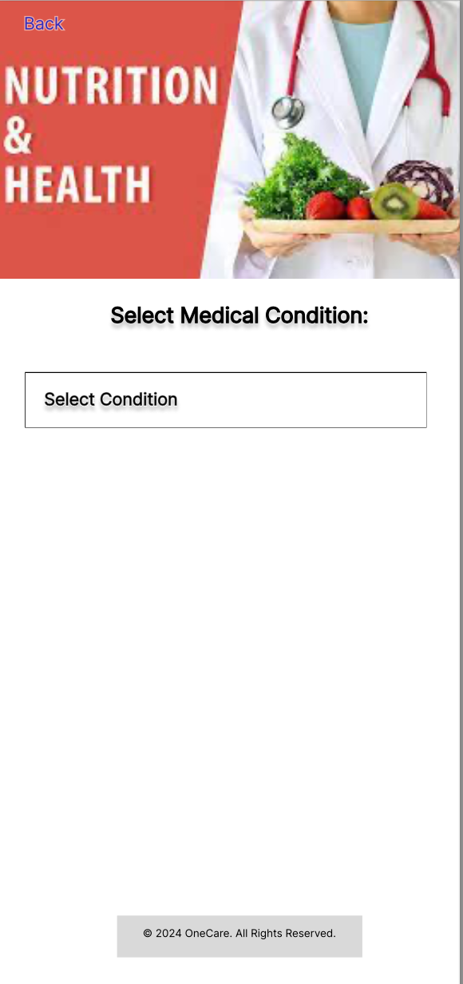
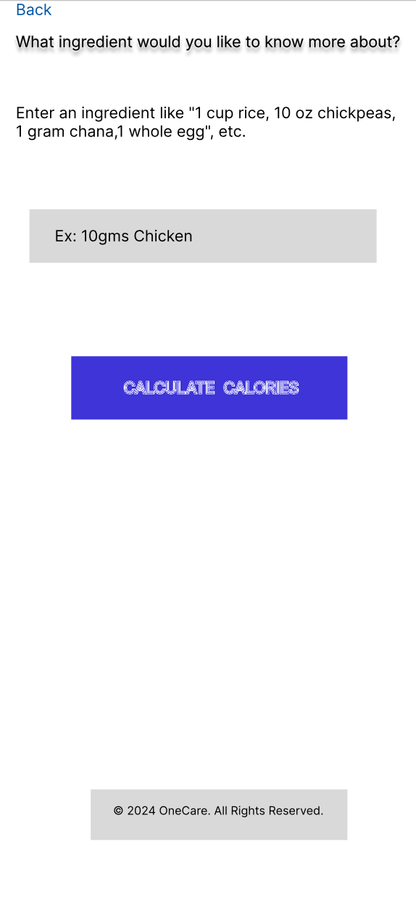
FIGMA

Slide 36

Metrics

Slide 37
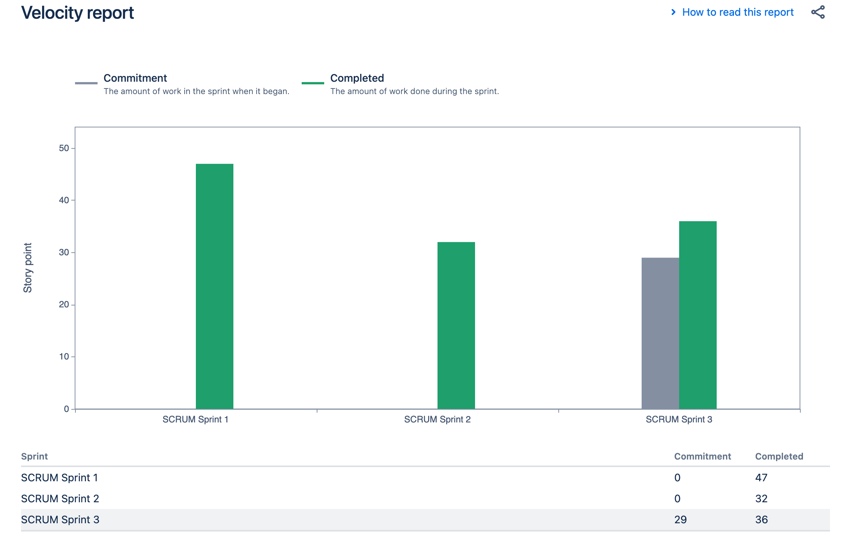
Team Members Velocity report

Slide 38
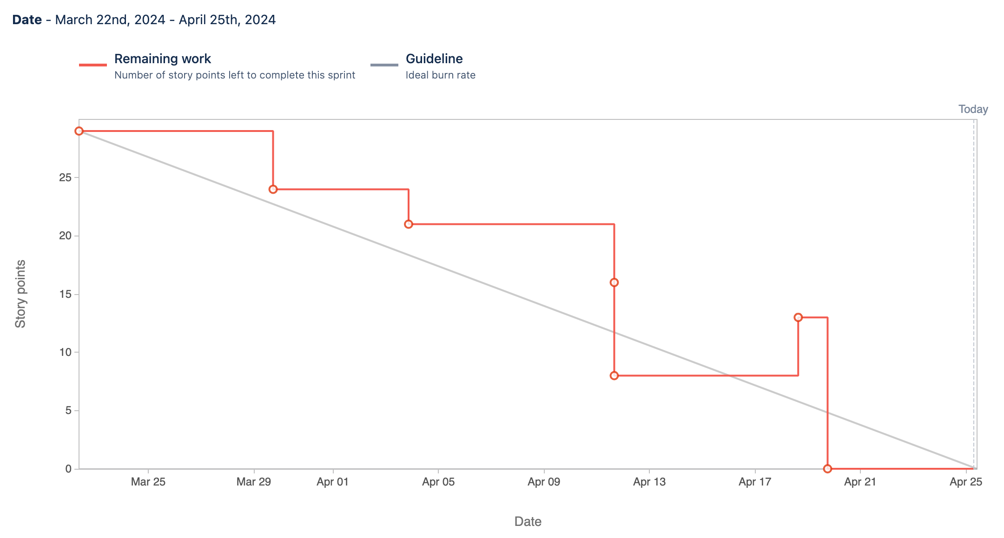
Sprint Burndown Chart

Slide 39
RETROSPECTIVE

Slide 40
What Went Well
Good Collaboration and pairing work done
Communication among team members was excellent. We were all on the same page throughout the sprint.
Deliverables on time.
Incorporated professors feedback

Slide 41
What needs Improvement
Our meetings could have been more focused
Coding standards implementation
some misunderstandings about task priorities, which led to confusion and delays.
Updates on how much the work is done clearly

Slide 42
Next Steps
Exploring time management techniques and tools could assist team members in prioritizing tasks and managing their workload more effectively
Reviewing and resolving any issues found later
Update Documentations as and when required later

Slide 43

Project Demo – Sprint 3

Slide 44

Links
GitHub source code : https://github.com/more-aishwarya/OneCareCapstone
Github Wiki page : https://github.com/more-aishwarya/OneCare/wiki/OneCare-%E2%80%90-Pace-University-Capstone-Project

Slide 45

THANK YOU

